Slide 1
- Ideation
If Variable is the main cause for fault?
Then Var change`s patch can be prioritized.
Var change Node existence template weighted in case

Slide 2
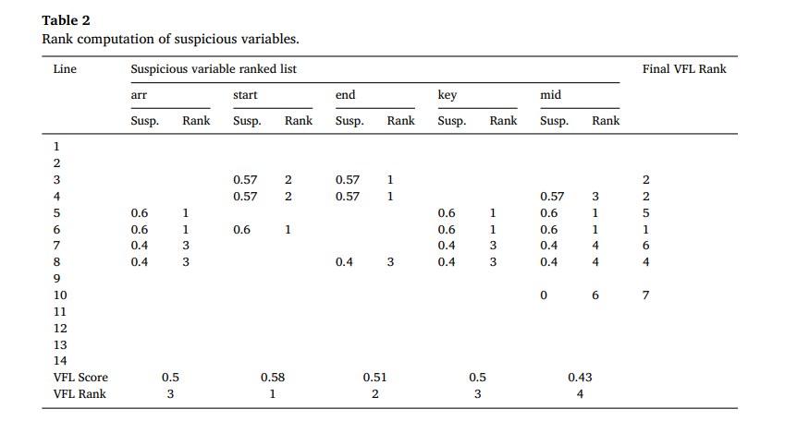
- Ideation

Slide 3
- Ideation
 | Var1 | Var2 | Var3 | Suspicious Ranking
Statement1 | 0.8 | 0.8 |  | 1
Statement2 | 0.7 |  |  | 2
Statement3 |  |  | 0.65
Statement4 |  | 0.4
Statement5 |  |  | 0.55
VFL score | 0.75 | 0.6 | 0.6
Var2 and Var3 contribution level for suspicious computation same?
Suggestion : Simple distance X
Stdev

Slide 4
- Plan
Effectiveness of variable for fault Verification
Apply for ConFix
Experiment plan
1) Apply VFL for ConFix
2) Analysis VFL with new formula(still stdev)
3) Apply for 2) experiment for ConFix

Slide 5
Automatic program repair
2020-11-19
JuHyoung Kim
kjhkjh75@naver.com

Slide 6
- Research Goal
Pattern extraction using VFL
APR with above information.

Slide 7
- Process
Done
PAR paper
Doing
ConFix
Plan
Ideation

Slide 8
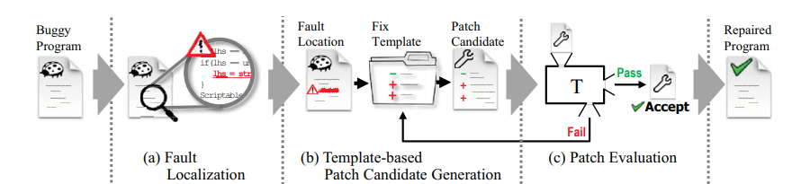
- PAR : Pattern-Based APR
One cycle is called a generation.

Slide 9
- PAR : Pattern-Based APR
Fault Localization
1) Uses statistical fault localization based on test cases.
2) This technique first executes two groups of test cases(Pass and fail)
3) Records the statement-based coverage of both test case groups
4) Comparing the coverage of each statement (four outcomes)
1. Covered by both groups 0.1
2. Covered only by Passed 0.0
3. Covered only by failed 1.0
4. Not covered by either 0.0 (PAR)

Slide 10
- PAR : Pattern-Based APR
Fix Templates
Fix templates are program editing scripts that rewrite a program`s AST
Each fix template defines three steps to edit a program
1) AST analysis : scans a given program`s AST and analyzes the given fault location and its adjacent locations.
2) context check : examines whether the given program can be edited by a template by inspecting the analyzed AST
3) program editing : If it is editable, Par rewrite the given program`s AST based on predefined editing script in the template

Slide 11
- PAR : Pattern-Based APR
Fix templates
Creating Fix Templates : inspect patches in each pattern
1) Program patches change a program`s AST
-> can compute AST difference
2) transform these differences into editing scripts in a fix template
3) Patches in the same pattern may have various ASTs even though their semantic changes are identical

Slide 12
- PAR : Pattern-Based APR
Fix templates
Context check step
1) extract context information such as the existence of an array access from patches, necessary to check whether our approach can edit a program by using a fix template.
2) Add the AST step to the template, scans a program`s AST at the fault location and extracts AST elements.
3) Identify these elements by looking up fix patterns

Slide 13
- PAR : Pattern-Based APR
Applying Fix Templates
PAR applies a template to a fault location in each individual generation.
PAR first takes a program and a fault location as input values.
PAR then executes the AST analysis step in the template to collect necessary information (variable types and method parameters)
PAR runs the context check step to if the program has appropriate context to apply the given template.
If the context check passes, our approach executes the template`s program editing step to rewrite the program`s AST of the given fault location.
AST rewriting includes node addition, parameter replacement, and predicate removal.

Slide 14
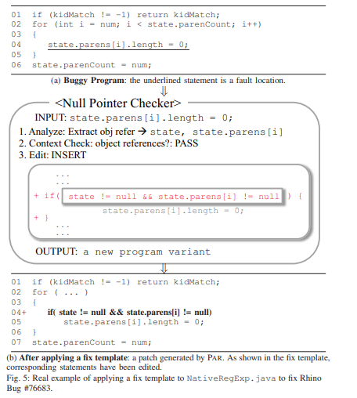
- PAR : Pattern-Based APR
Applying Fix Templates
Several templates pass the context checking for given fault location
-> PAR randomly selects one of the passing templates.

Slide 15
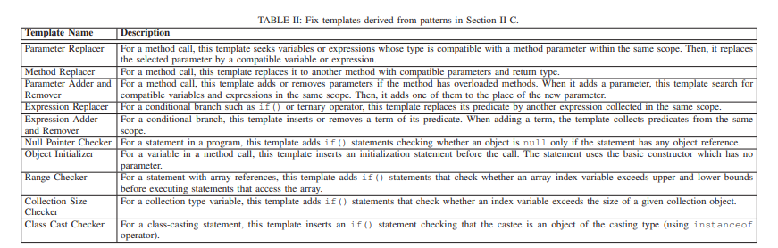
- PAR : Pattern-Based APR
List of Fix Templates

Slide 16
- PAR : Pattern-Based APR
Fitness Evaluation
Computes a value representing the number of passing test cases of the variant.
PAR chooses program variants by using a tournament selection scheme
- > Patch pattern prioritization?

Slide 17
Automatic patch generation with context-based change application
Jindae Kim1 · Sunghun Kim1
Empirical Software Engineering 2019

Slide 18
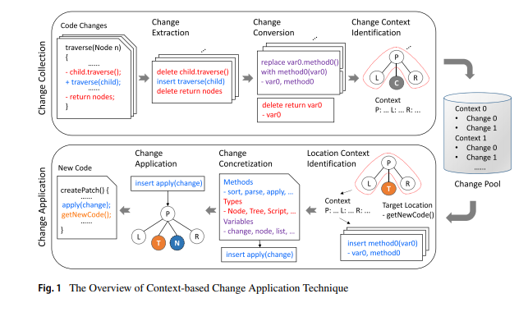
- Context-Based Change Application Technique

Slide 19
- Context-Based Change Application Technique
Patch Generation
1. Patch Generation Process
ConFix identifies all code lines covered by given test cases.
For each covered line, ConFix identifies fix location candidates from the lines
For each fix location candidate, ConFix tries to apply a certain number(maxChangeCount) of applicable changes
For each change, ConFix tries to concretize them for maxTrials times
Three rule for termination
- passed all given test cases.
- generated and validated a certain number of patch candidates.
- Consumed all time

Slide 20
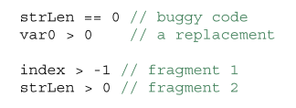
- Context-Based Change Application Technique
Patch Generation
2. Identifying Fix Location Candidates
To identify fix location candidates, use SBFL.
ConFix first lists up all AST nodes correspond to the covered line and identifiers their context.

Slide 21
- Contents
Abstract
Introduction
Context-Based Change Application Technique
Patch Generation
Evaluation Design
Result
Threats to Validity
Related work
Conclusion

Slide 22
- Abstract
Search problem major issue : search space size and navigation
Effective patch generation should have a large search space with a high probability that patches for bugs are included, need to locate patches effectively
Confix, collects AST changes from human-written patches with their AST context
Confix selects a necessary change for a possible fix location more effectively

Slide 23
- Introduction
One popular approach of automatic patch generation is the generate-and validate approach
Search problem
-> where to fix(fix locations) and how to fix(applicable changes)
Search problem two major issue
1) Search space size
2) navigation
Limited fix types
To expand the search space and generate various patch candidates, mine changes from human-written patches or collect code fragments from software repositories for resources for patches
These expansion makes the navigation more difficult

Slide 24
- Introduction
To address these issues, propose Confix (context-based change)
Key idea is collects abstract changes and applies a collected changes a possible fix location only if their AST contexts are matched
ConFix compares AST contexts of a change and a target location defined by parent, left and right nodes, and applies the change to the location only if their contexts are matched.
ConFix advantages
1) ConFix can avoid changes which developers may not produce, and tries to mimic collected human-written changes more similarly.
2) ConFix can avoid to select fix locations which developers may not want to modify

Slide 25
- Introduction
Evaluate ConFix with Defects4j datasets.
Collected over 6K human-written patches for patch generation
ConFix exploited changes and contexts to generate patch candidates until found found a patch for each bug
When using specific AST contexts, needed to consider average two changes
Per each possible fix location
Contributions
Introduce ConFix, leverages human-written changes and their contexts
Provide empirical evaluation results of ConFix and generated patches on Defects4j
Present a detailed analysis on the effectiveness of ConFix

Slide 26
- Context-Based Change Application Technique
Change Collection
Main purpose of change collection is building a change pool by collecting changes
Changes represented by source code form are not suitable, since easily affected by specific user-defined identifiers or coding style
So, Extract AST subtree changes from human-written patches by applying a source code differencing technique(Change Extraction)
Polished to more generally applicable form (Change Conversion)
The changes are categorized by their AST contexts and stored in a change pool(Change Context Identification)

Slide 27
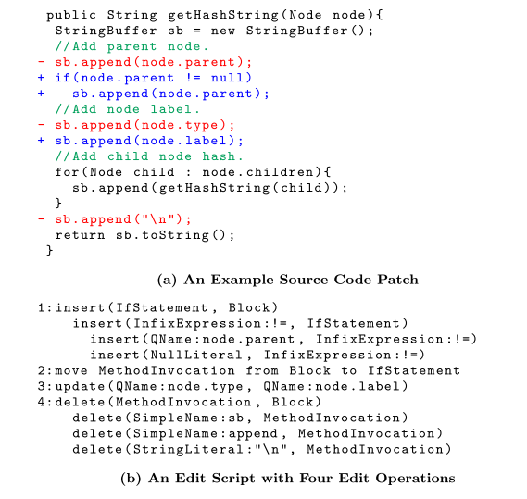
- Context-Based Change Application Technique
Change Collection
Change Extraction
Child and parent relationship

Slide 28
- Context-Based Change Application Technique
Change Collection
Change Extraction
The first hunk represents an insertion of a null checker
The second one shows that a field type is updated to label,
Last, method call deletion.
One patch may consist of several individual changes
Collect separate individual changes
Using small changes increases the probability that such changes are repeatedly used to generate other patches.

Slide 29
- Context-Based Change Application Technique
Change Collection
Change Extraction
Used a source code differencing tool for extracting individual changes.
It matches AST nodes between old and new ASTs to identify unchanged nodes.
Unmatched nodes in the old AST -> deleted unmatched nodes in the new AST -> inserted
If there matched nodes, but different position -> moved

Slide 30
- Context-Based Change Application Technique
Change Collection
2. Change Conversion
Purpose of change extraction is to obtain changes applicable to other locations to reproduce similar changes.
Generated edit operations are often not suitable
Insert operation may be applied to somewhere else independently, it may cause errors since the added code fragment is not a complete if statement
To address this, employ replace change type, insert and move operations with one replacement
Figure

Slide 31
- Context-Based Change Application Technique
Change Collection
2. Change Conversion
The change conversion steps.
1) Divide move operations into a pair of delete and insert operations.
2) Extend each insert or delete operation to all descendant nodes of its changed nodes
3) Remove any operation if a changed AST is a subtree of another operation`s changed AST
4) Find all insert-delete pairs applied to the same location and combine into replace type change.

Slide 32
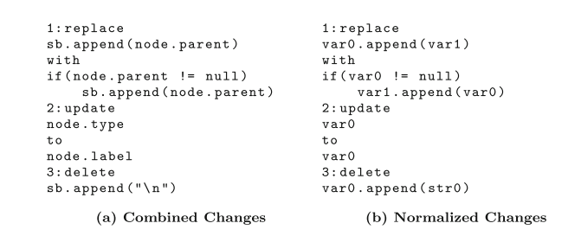
- Context-Based Change Application Technique
Change Collection
2. Change Conversion
Definition 1 (AST subtree Changes)
- insert t: insert a subtree t.
- update v1 to v2 : update a node`s value from v1 to v2
- replace t1 with t2 : replace a subtree t1 with t2

Slide 33
- Context-Based Change Application Technique
Change Collection
2. Change Conversion
Technique normalizes changes with two principles
- Consistency and order preserving
Consistency : same identifier or string literal should be replaced with the same unique abstract name.
Order preserving : should assign the same abstract name to user-defined names or string literals shown in the same location of two identical subtrees.
sb.append(), strBuf.append()
-> should replaced with the same abstract name var0
Figure

Slide 34
- Context-Based Change Application Technique
Change Collection
2. Change Conversion
During normalization, in old and new subtrees were separately normalized
During change application, only abstract values on a new subtree are replaced with concrete values.(new subtrees)
Old subtree is normalized to identify the same changes and aggregate them
Figure

Slide 35
- Context-Based Change Application Technique
Change Collection
3. Change Context Identification
A context of a change describes code fragments near the change, hence can apply changes to target locations with similar neighbor code fragments by comparing contexts.
Use parent of the subtree`s root, the root`s left and right nodes to define contexts.
Parent node represent the location where a changed code fragment belons.
Left and right nodes indicate code fragments before and after the changed code fragment respectively.
Use contexts to verify that code fragments near a target location is similar to code fragments near a change.

Slide 36
- Context-Based Change Application Technique
Change Collection
3. Change Context Identification
Achieve this goal, employ source code fingerprinting techniques which often used to identify similar code.
Specifically, use the node type and node type hash of nodes to define the AST context.
Node type is the AST node type of an AST node, which simply represents the type of code fragments(assignment, method call)
Node type hash is that can represent the structure of the whole AST subtree rooted at an AST node.

Slide 37
- Context-Based Change Application Technique
Change Collection
3. Change Context Identification
Definition 2 : Dyck word Dn of node n with node type n.type is defined as follows.
A hash value contains both type and structure of AST nodes which correspond to a code fragment.

Slide 38
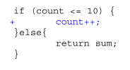
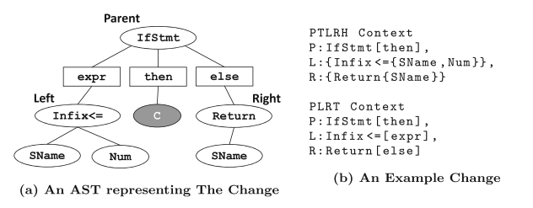
- Context-Based Change Application Technique
Change Collection
3. Change Context Identification

Slide 39
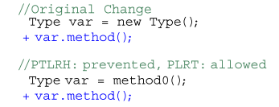
- Context-Based Change Application Technique
Change Collection
3. Change Context Identification
Node C is the root of the changed AST
PTLRH context shows the type and syntactic location of the parent node and the hash of left and right nodes.

Slide 40
- Context-Based Change Application Technique
Change Collection
3. Change Context Identification
Node C is the root of the changed AST
PTLRH context shows the type and syntactic location of the parent node and the hash of left and right nodes.

Slide 41
- Context-Based Change Application Technique
Concretization Strategy
ConFix convert Abstract changes to concrete changes
ConFix employs Hash Match and Type Compatible methods

Slide 42
- Context-Based Change Application Technique
Concretization Strategy
Hash Match Method
Collects code fragments and their node type hash from buggy code
List up code fragments with the same node type hash for a changed subtree of the change.
Then it replaces all abstract values with concrete value of corresponding AST node representing one of the code fragments.
replace var0==0 with var0>0 for buggy code with two code fragments as follows

Slide 43
- Context-Based Change Application Technique
Concretization Strategy
Hash Match Method
Try to find code fragments with the same structure by comparing node type hashes.
Node type hash for change concretization doesn`t include specific operators.
After code fragments are listed, ConFix selects a code fragments most closely related to the buggy code.
To compute closeness of the buggy code and a code fragment, ConFix breaks all identifiers appeared in both of them into tokens, and creates token vectors containing token frequencies.

Slide 44
- Context-Based Change Application Technique
Concretization Strategy
Hash Match Method
Three tokens (str, Len, index)
Token vectors are (1,1,0) and (0,0,1) buggy code and fragment1
Token vectors are (1,1,0) fragment 2
Then choose fragment2
If same distance, ConFix tries more frequent code fragment first

Slide 45

- Context-Based Change Application Technique
Concretization Strategy
Hash Match Method
Since their changed subtrees only have one node, any node with the same node type will be listed. -> less useful than usage examples
Try to find code fragments which can be used for the estimated code fragment.

Slide 46
- Context-Based Change Application Technique
Concretization Strategy
2. Type Compatible Method
TC method collects identifiers from buggy code, and selects a concrete name for each abstract name by considering type compatibility.

